Slide 1
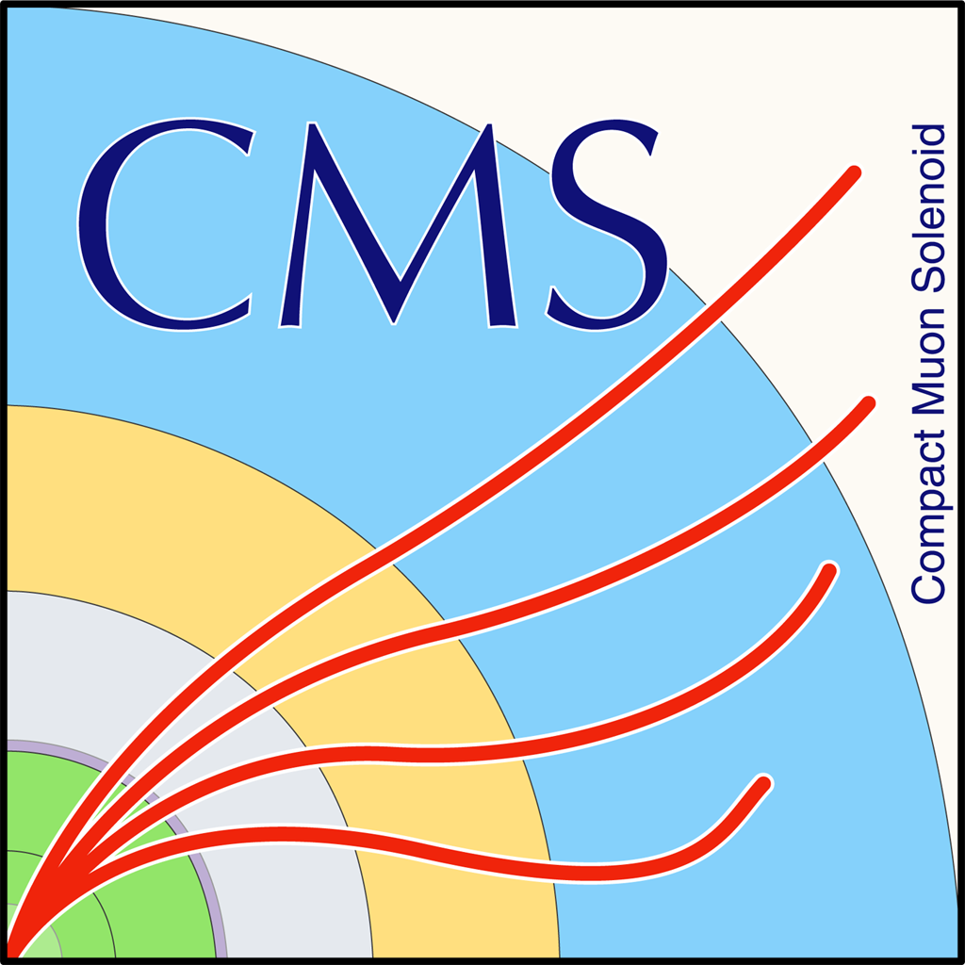

NTUA Top Tagger Tag & Probe methodology
G. Bakas, K. Kousouris, I. Papakrivopoulos, G. Tsipolitis

Slide 2
Motivation
The main background for this analysis is QCD
A data driven method is used for subtracting it
The method relies on the assumption that by inverting the b-tagging requirement in the signal region (SR) we can have the shape of the QCD contribution
The tagger is required not to use b-tagging information and the full range of the subjet mass
An in-house BDT was developed to overcome this limitation
DeepAK8 uses b-tagging
Older top taggers use jet mass cuts

Slide 3
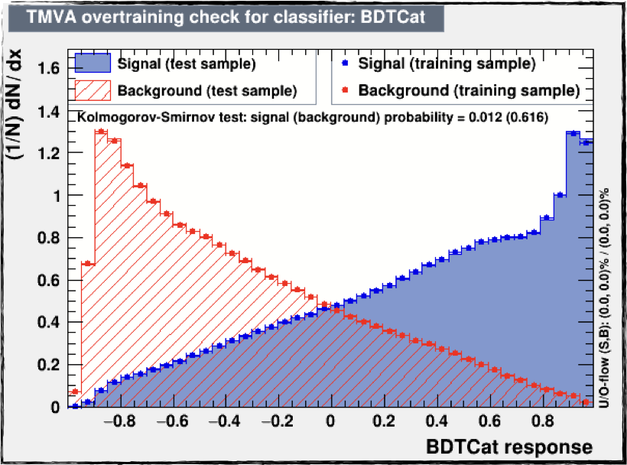
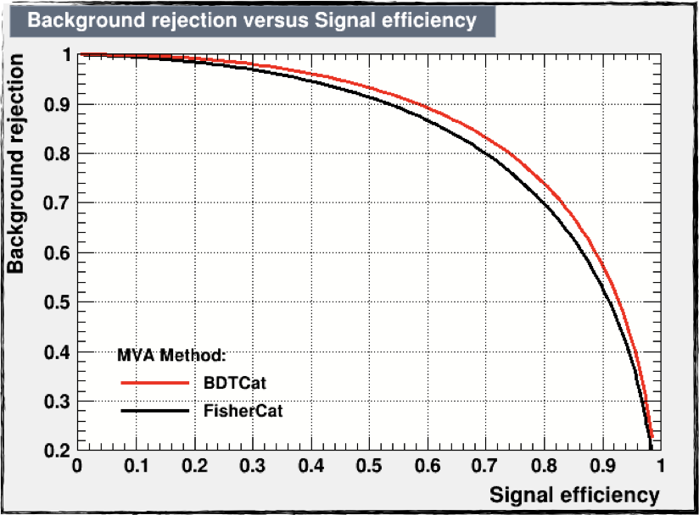
BDT Output
In house developed top tagger, for top candidate jets
BDT based
Input variables:
N-subjetiness: 𝜏1, 𝜏2, 𝜏3
Energy correlation functions (ECF) ECFB1N2, ECFB1N3, ECFB2N2, ECFB2N3
Soft drop mass of the leading and subleading subjets
Fraction of the jet over the of all the jets in the event
No b-tagging requirements
Phase space split in categories based on the pt of the jet:
[400, 600) GeV
[600, 800) GeV
[800, 1200) GeV
[1200, Inf) GeV
Different training and working point for each year (Signal) and QCD (Bkg) samples used in the training
The use of DeepAK8 was investigated but it uses b-tagging so it is not applicable in our use case
2018

Slide 4
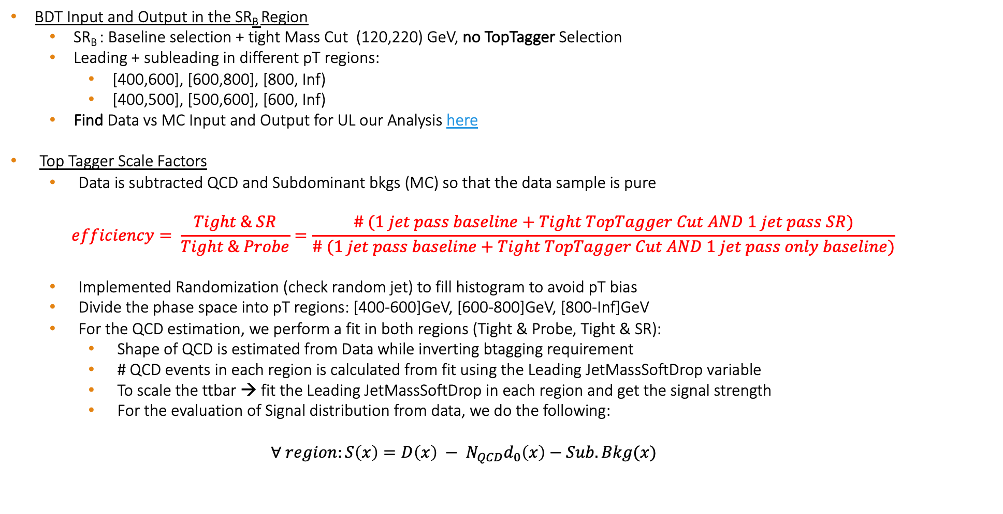
Overview
BDT Input and Output in the SR_{B} Region
SR_{B} : Baseline selection + tight Mass Cut (120,220) GeV, no TopTagger Selection
Leading + subleading in different pT regions:
[400,600], [600,800], [800, Inf)
[400,500], [500,600], [600, Inf)
Find Data vs MC Input and Output for UL our Analysis here
Top Tagger Scale Factors
Data is subtracted QCD and Subdominant bkgs (MC) so that the data sample is pure
$$efficiency= \frac{Tight \& SR}{Tight \& Probe}=\frac{\# (1 jet pass baseline+Tight TopTagger Cut AND 1 jet pass SR)}{\# (1 jet pass baseline+Tight TopTagger Cut AND 1 jet pass only baseline)}$$
Implemented Randomization (check random jet) to fill histogram to avoid pT bias
Divide the phase space into pT regions: [400-600]GeV, [600-800]GeV, [800-Inf]GeV
For the QCD estimation, we perform a fit in both regions (Tight & Probe, Tight & SR):
Shape of QCD is estimated from Data while inverting btagging requirement
# QCD events in each region is calculated from fit using the Leading JetMassSoftDrop variable
To scale the ttbar → fit the Leading JetMassSoftDrop in each region and get the signal strength
For the evaluation of Signal distribution from data, we do the following:
$$∀ region:S\left(x\right)={D\left(x\right) − N}_{QCD}d_{0}\left(x\right)−Sub.Bkg(x)$$
Fraction of events used in the cross section measurement that are also used in the Top Tagger SF measurement is of the order of 35%
Notes:
We have measured the fraction of events used in the cross section measurement that are also
669 used for the SF measurement to be of the order of 35% (due to phase-space differences and
670 randomization in the SF measurement). We consider that this fraction is reasonably small.

Slide 5
Scale Factors
2016 preVFP
2016 postVFP
[400, 600]
[600, 800]
[400, 600]
[600, 800]
[800, Inf)
[800, Inf)
[800, Inf)
[800, Inf)
[400, 600]
[600, 800]
[400, 600]
[600, 800]
2017
2018

Slide 6
Scale Factors
[400, 500]
[600, Inf)
[500, 600]
[400, 500]
2016 preVFP
2016 postVFP
[500, 600]
[600, Inf)
[400, 500]
[500, 600]
[600, Inf)
[500, 600]
[600, Inf)
[400, 500]
2017
2018

Slide 7
Systematic Uncertainties Breakdown

Slide 8
Systematic Uncertainties Breakdown

Slide 9
Backup

Slide 10
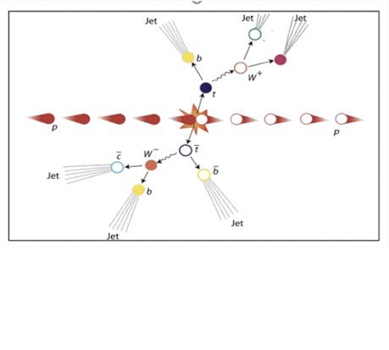
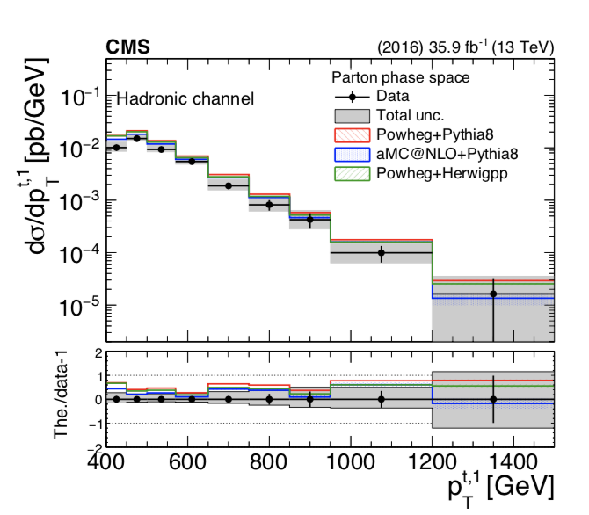
Analysis Overview
Differential cross section for boosted ttbar pair fully hadronic final state
Trying to identify two big jets that contain the products of the top/anti-top decay.
A NN, for tagging ttbar events was used in TOP-18-013
A BDT for tagging jets as tops is used in this analysis
Notes:
We have measured the fraction of events used in the cross section measurement that are also
669 used for the SF measurement to be of the order of 35% (due to phase-space differences and
670 randomization in the SF measurement). We consider that this fraction is reasonably small.

Slide 11
Motivation
The main background for this analysis is QCD
A data driven method is used for subtracting it
The method relies on the assumption that by inverting the b-tagging requirement in the signal region (SR) we can have the shape of the QCD contribution
This can be verified by a set of closure tests
The tagger is required to not use b-tagging information
The use of DeepAK8 was investigated but it uses b-tagging so it is not applicable in our use case
An in-house BDT was developed to overcome this limitation
Notes:
We have measured the fraction of events used in the cross section measurement that are also
669 used for the SF measurement to be of the order of 35% (due to phase-space differences and
670 randomization in the SF measurement). We consider that this fraction is reasonably small.

Slide 12
Shape Comparison of the probe jet and the jets used for the measurement (double Filled)
2018
Data
MC
Notes:
We have measured the fraction of events used in the cross section measurement that are also
669 used for the SF measurement to be of the order of 35% (due to phase-space differences and
670 randomization in the SF measurement). We consider that this fraction is reasonably small.

Slide 13
Signal Selection
Control Region Selection
Variables | Selected Cut
pT leading jets | > 450 GeV
pT 2nd leading jets | > 400 GeV
Njets | > 1
N leptons | = 0
|eta| (both leading jets) | < 2.4
mJJ | > 1000 GeV
jetMassSoftDrop (only for fit) | (50,300) GeV
Top Tagger | > 0.2
B tagging (2 btagged jets) | > Medium WP
Signal Trigger
Variables | Selected Cut
pT leading jets | > 450 GeV
pT 2nd leading jets | > 400 GeV
N leptons | = 0
|eta| (both leading jets) | < 2.4
mJJ | > 1000 GeV
jetMassSoftDrop (only for fit) | (50,300) GeV
Top Tagger | > 0.2
B tagging (0 btagged jets) | < Medium WP
Control Trigger

Slide 14
Shape Comparison of the probe jet and the jets used for the measurement
2018
Data
MC
Notes:
We have measured the fraction of events used in the cross section measurement that are also
669 used for the SF measurement to be of the order of 35% (due to phase-space differences and
670 randomization in the SF measurement). We consider that this fraction is reasonably small.

Slide 15
Top Tagger Input Variables
2018
Leading jet

Slide 16
Top Tagger Input Variables
2018
Second Leading Jet
NTUA

Slide 17
Top Tagger Output
2018
Leading Jet
Second Leading Jet

Slide 18
Top Tagger Efficiencies

Slide 19
TagAndProbe Efficiency per Pt region
[800, Inf)
[800, Inf)
[600, 800]
[600, 800]
[400, 600]
[400, 600]
2016 preVFP
2016 postVFP
[800, Inf)
[400, 600]
[600, 800]
[600, 800]
[800, Inf)
[400, 600]
2017
2018

Slide 20
TagAndProbe Efficiency per Pt region (JMAR regions)
[400, 500]
[500, 600]
[600, Inf)
[400, 500]
[500, 600]
[600, Inf)
2016 preVFP
2016 postVFP
[600, Inf)
[400, 500]
[500, 600]
[500, 600]
[600, Inf)
[400, 500]
2017
2018

Slide 21
Scale Factor Values

Slide 22
Data vs MC
No SF applied
2018
SF applied

Slide 23
Data vs MC plots
No SF applied
2018
SF applied

Slide 24
2018
Data vs MC plots
No SF applied
SF applied

Slide 25
Data vs MC plots
No SF applied
2018
SF applied

Slide 26
DeepAK8 backup

Slide 27
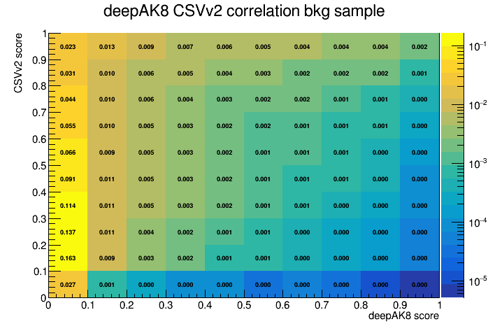
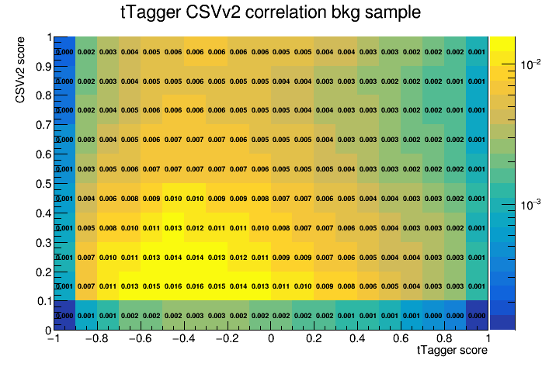
Btagging Correlation to DeepAK8 or TopTagger
deepAK8 b tagging correlation bkg sample
tTagger b tagging correlation bkg sample
b tagging score
b tagging score

Slide 28
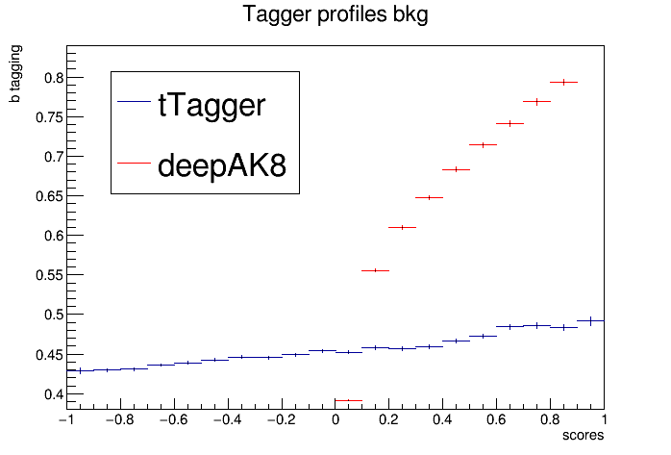
Btagging Correlation to DeepAK8 or TopTagger profiles
b-tagging mean value
vs
top tagging values

Slide 29
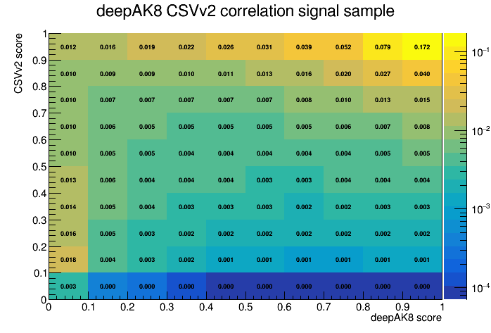
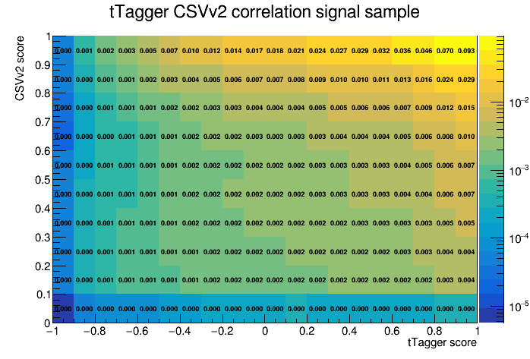
Btagging Correlation to DeepAK8 or TopTagger
deepAK8 b tagging correlation signal sample
tTagger b tagging correlation signal sample
b tagging score
b tagging score

Slide 30
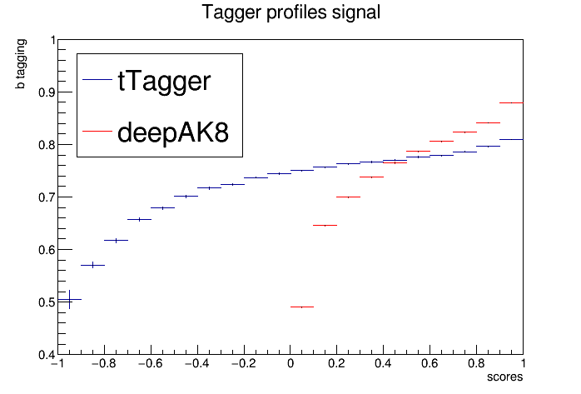
Btagging Correlation to DeepAK8 or TopTagger profiles
b-tagging mean value
vs
top tagging values

Slide 31
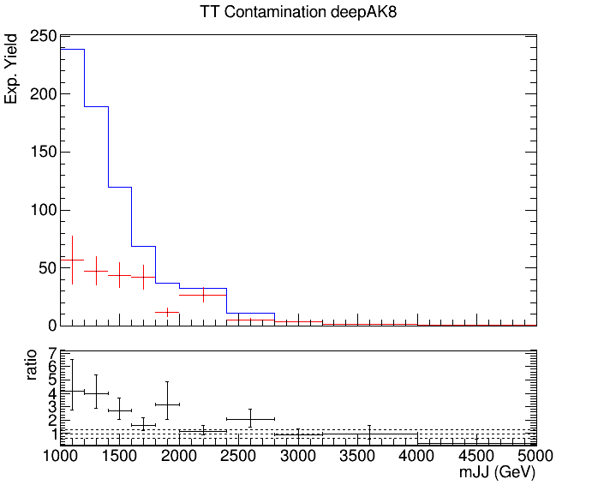
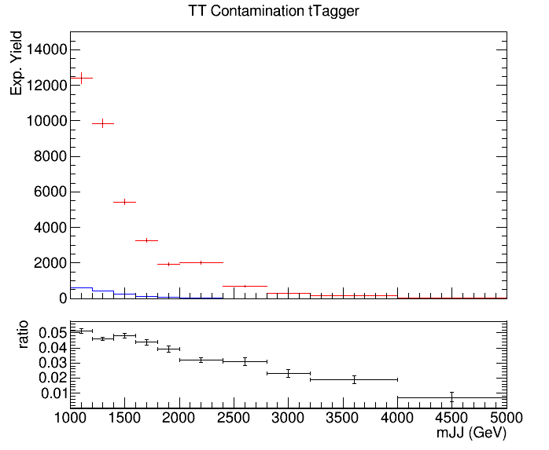
Control Region Contamination
Expected yield from QCD Bkg samples and TT Signal sample in the CR (btag == 0) vs mJJ
The QCD contribution is used to get the QCD shape
Control Region QCD sample
Control Region QCD sample
Control Region TT sample
Control Region TT sample

Slide 32
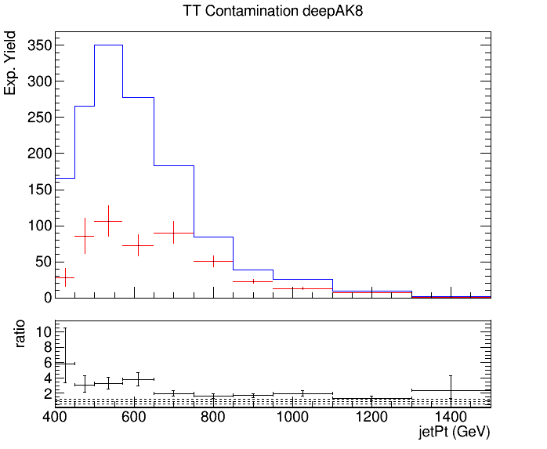
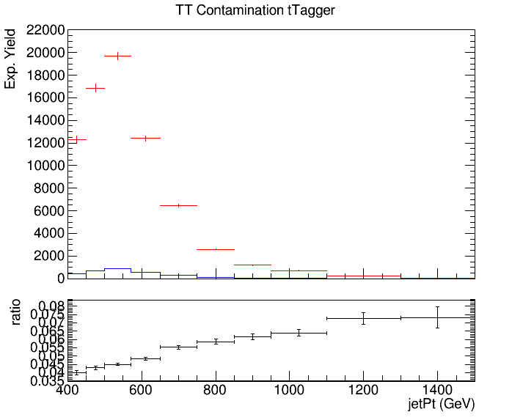
Control Region Contamination
Expected yield from QCD Bkg samples and TT Signal sample in the CR (btag == 0) vs jetPt
The QCD contribution is used to get the QCD shape
Control Region QCD sample
Control Region QCD sample
Control Region TT sample
Control Region TT sample

